Slide 1











THESIS DEFENSE
Exchange Rate in Billing Document
Presented by: FA24SAP07

Slide 2


Our Team
Nguyen Hoang Dai Viet
Truong Chi Cuong
Developer Member
Developer Member
Le Thi Bich Thu
Nguyen Thu Trang
Functional Member
Functional Member

Slide 3








AGENDA
1. Introduction
2. Requirements
3. Implementation
4. Demonstration
5. Conclusion

Slide 4
1. INTRODUCTION
1

Slide 5





COMPANY BACKGROUND
FPT Software is a global technology solutions provider, headquartered in Vietnam.
As a pioneer in digital transformation, FPT Software delivers world-class services in Smart factory, Digital platforms, RPA, AI, IoT, Cloud, AR/VR, BPO, and more with strict compliance to global standards.
FPT Software is currently using SAP 4/HANA Sales and Distribution.
2

Slide 6



LIMITATIONS OF CURRENT PROCESS
Lack of Flexibility in Exchange Rate Adjustments
No Real-Time Updates During Multi-Step Processes
Inconsistent Exchange Rate
Delayed Error Identification
3

Slide 7
2. REQUIREMENTS
4

Slide 8
REQUIREMENTS
Research Exchange Rate Behavior: Analyze how exchange rates are handled in standard sales processes.
Set Editable Fields in Billing Document: Configure billing documents to allow specific fields related to exchange rates to be editable.
Ensure Consistency When Posting to Journal Entry: Verify that the exchange rates used in billing documents are accurately reflected in journal entries.
5

Slide 9

STOCK SALES PROCESS
Step 2.1:
Create SO with Ref.
(VA01)
Step 3:
Check Availability
(CO09)
Step 1:
Receive purchase requests from customers
Create SO with Ref.?
Start
Step 2.2:
Create SO without Ref.
(VA01)
Step 6:
Post Goods Issue
(VL02N)
Step 5:
Pick Materials
(VL01N)
Step 4:
Create Outbound Delivery
(VL01N)
End
Step 7:
Create Billing Documents
(VF01)
Update?
Step 8:
Change Billing Documents
(VF02)
Step 9:
Post Billing Documents
(VF02)
6

Slide 10
RETURN PROCESS
Step 2.1:
Create SO with Ref.
(VA01)
Step 3:
Create Return Delivery
(VL01N)
Step 1:
Receive return requests from customers
Create SO with Ref.?
Start
Step 2.2:
Create SO without Ref.
(VA01)
Step 6:
Create Credit Memo
(VF01)
Step 5:
Remove Billing Block
(VA02)
Step 4:
Post Goods Receipt
(VL02N)
Update?
Step 8:
Change Credit Memo
(VF02)
Step 9:
Post Credit Memo
(VF02)
End
7

Slide 11
3. IMPLEMENTATION
8

Slide 12

SYSTEM LANDSCAPE
DEVELOPMENT PROCESS
FUNCTIONAL CONFIGURATION
9

Slide 13






SYSTEM LANDSCAPE
DEV
QAS
PRD
In this project, development system (DEV), quality assurance system (QAS), and production system (PRD) are consolidated into a single system to optimize resources and simplify management.
10

Slide 14
DEVELOPMENT PROCESS
Requirement
Analysis
Solution Design
Configuration & Coding
Testing
Accepted ?
No
End
User Acceptance
Test
User Training
Yes
11

Slide 15
FUNCTIONAL CONFIGURATION
1. COMPANY ENTERPRISE STRUCTURE
2. THE STOCK SALES & RETURN PROCESS
3. MASTER DATA
12

Slide 16
Client
(324)
Company Code
(FU24)
COMPANY ENTERPRISE STRUCTURE
Sales Organization
(FU24)
Distribution Channel
(FU)
Division
(FD)
Sale Area
Sales Office
(FU03)
Sales Group
13

Slide 17


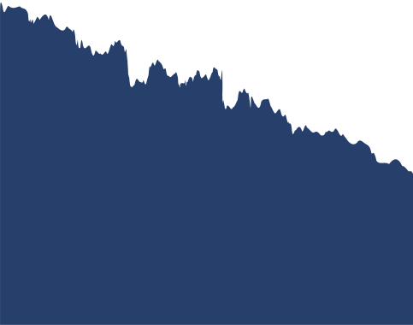
SET UP PRICING PROCEDURES
Define Condition Types
Set Pricing Procedures
Set Pricing Procedures Determination
STOCK SALES
& RETURN PROCESS
SET UP BILLING TYPES & SALES DOCUMENT TYPES
Define Billing Types
Define Sales Document Types
SET UP ITEM CATEGORIES
Define Item Categories
Assign Item Categories
14

Slide 18
SET UP SCHEDULE LINE CATEGORIES
Define Schedule Line Categories
Assign Schedule Line Categories
STOCK SALES
& RETURN PROCESS
COPY CONTROL
Copy Control: Billing Document to Sales Document
SET UP EXCHANGE RATE TYPES
Maintain Currency Translation Exchange Rate Types
Define Translation Ratios for Currency Translation
15

Slide 19




MASTER DATA
CUSTOMER MASTER DATA
Create New Business Partner
Assign Exchange Rate Type to Business Partner
MATERIAL MASTER DATA
Create New Material
Create Condition Records
16

Slide 20
4. DEMONSTRATION
17

Slide 21

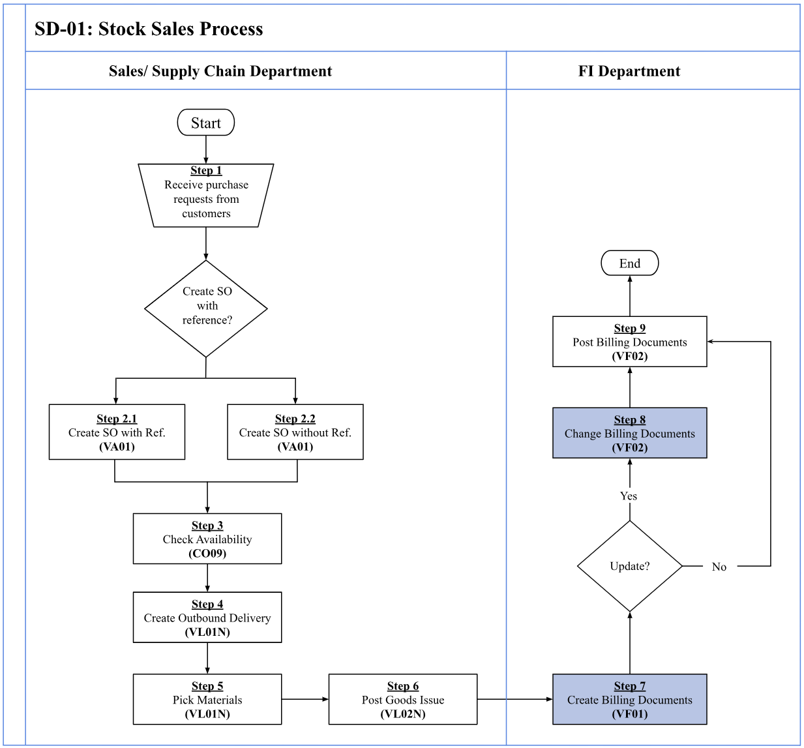

STOCK SALES PROCESS
18

Slide 22
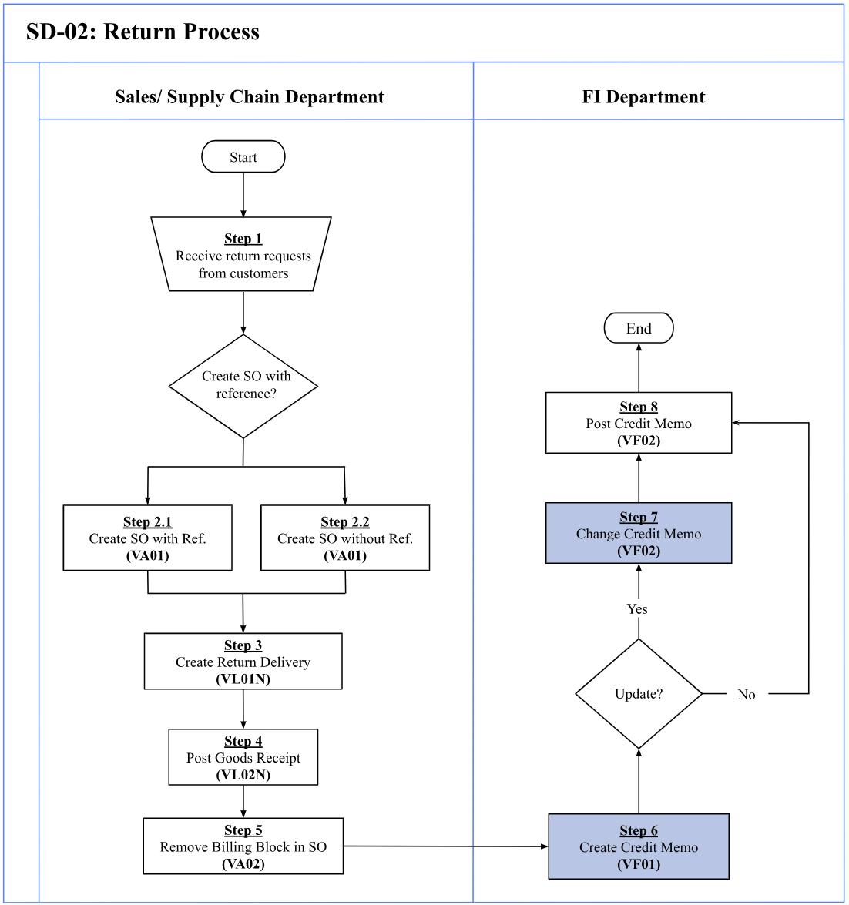
RETURN PROCESS
19

Slide 23
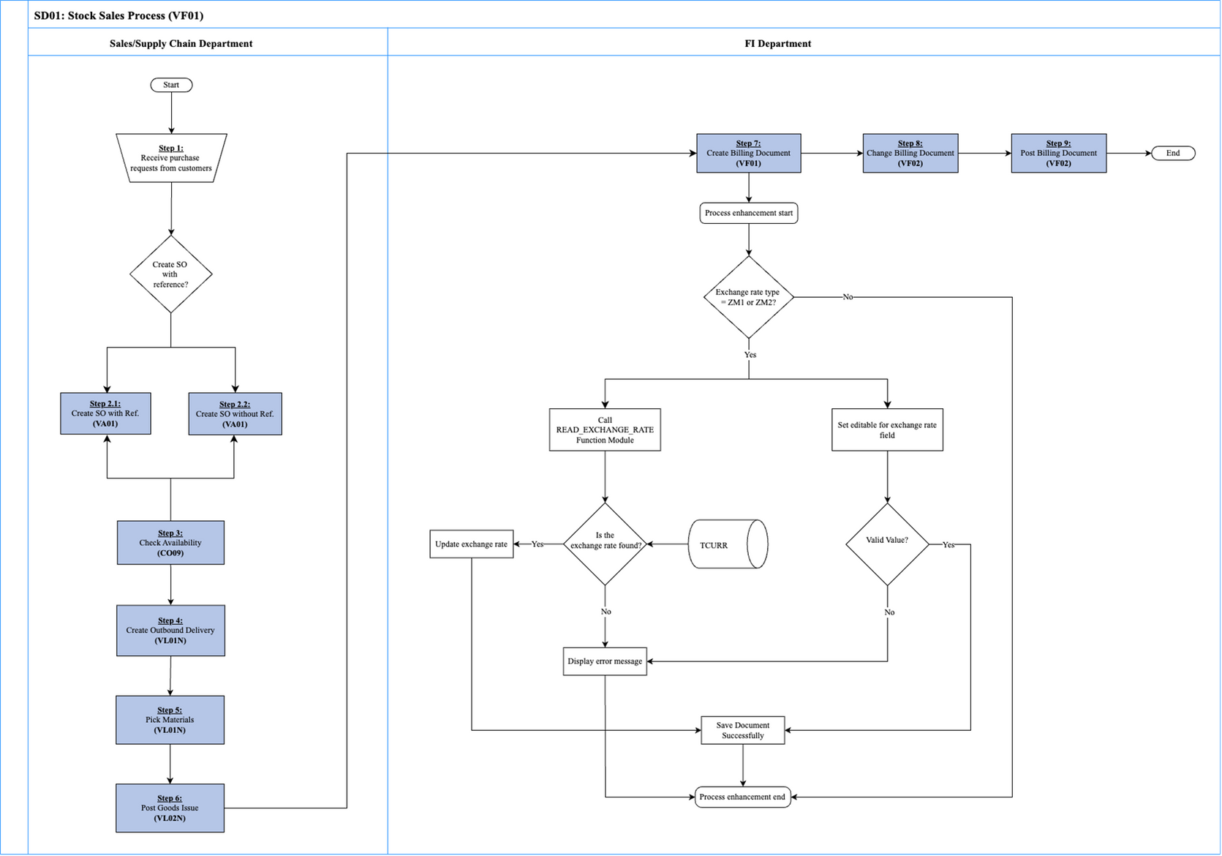
STOCK SALES PROCESS
20

Slide 24
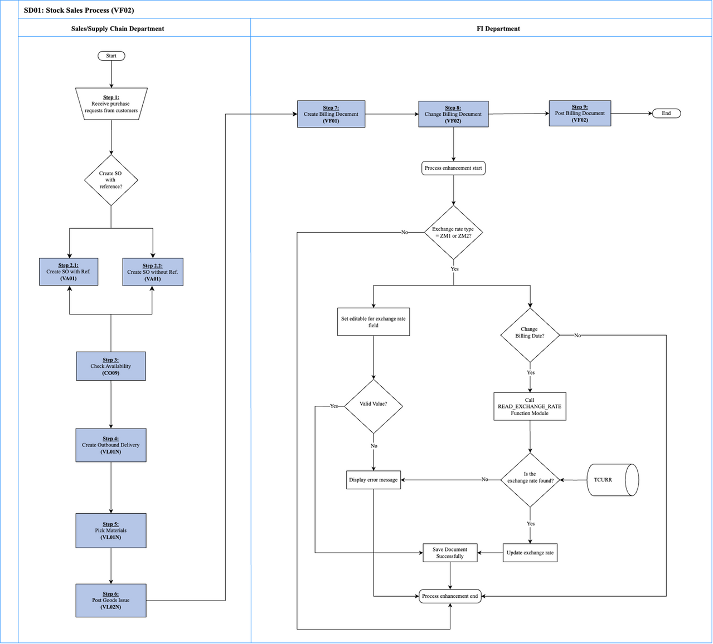
RETURN PROCESS
21

Slide 25
5. CONCLUSION
22

Slide 26


In conclusion, the project "Exchange Rate in Billing Document" with its enhancements has supported improving the accuracy of exchange rates in SAP billing documents, ensuring the flexibility to adjust exchange rates to meet customer needs. Additionally, enabling the editing of exchange rate fields has provided users with greater control, addressing the limitations of the standard SAP SD module.
Despite some limitations during our project, such as confusion about where to start and spending significant time researching and identifying suitable enhancements for the topic, as well as gathering information for the project, we gained valuable lessons.
Through this process, we learned how to work effectively
as a team, manage deadlines efficiently, and acquire
new knowledge and technical skills.
A
C
23

Slide 27



THANK YOU FOR LISTENING!
Presented by: FA24SAP07

